Slide 1
Sy.Sol 6120:
Acoustic Parameters Training (TAT)
Linda Wang
HW engineer, GC-CAL
Feb 18, 2005

Slide 2
Sy.Sol 6120:Acoustic Parameters Training (TAT)
Agenda:
TAT: Audio panel
TAT: Audio data section - general
TAT: Audio data section - common
TAT: Audio data section - different

Slide 3
Sy.Sol 6120:Acoustic Parameters Training (TAT)
Agenda:
TAT: Audio panel
TAT: Audio data section - general
TAT: Audio data section - common
TAT: Audio data section - different

Slide 4
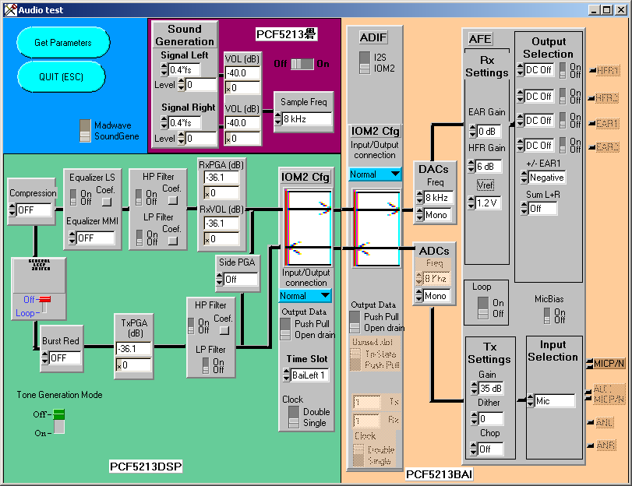
TAT: audio panel

Slide 5
Sy.Sol 6120:Acoustic Parameters Training (TAT)
Agenda:
TAT: Audio panel
TAT: Audio data section - general
TAT: Audio data section - common
TAT: Audio data section - different

Slide 6
TAT: Audio Data Section
Common parameter setting for all audio mode
RxHpf: Rx path high pass filter
TxHpf: Tx path high pass filter
RxTxLpf: Low pass filter for Rx and Tx
(coefficients are the same)
Wbs: Wideband synthesis algorithm.
BurstReductionLevel: Burst reduction

Slide 7
TAT: Audio Data Section
Different parameter setting for different mode
Gains
AULS: Rx equalizer for speaker frequency response compensation
DENS: Echo and noise suppressor algorithm
Hf: Half duplex echo suppressor
RxVol
Compression
Path parameter: choice of input/output

Slide 8
Sy.Sol 6120:Acoustic Parameters Training (TAT)
Agenda:
TAT: Audio panel
TAT: Audio data section - general
TAT: Audio data section - common
TAT: Audio data section - different

Slide 9
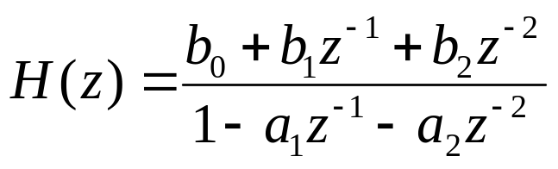
TAT: Audio Data Section - RxHpf
The filters are 4-th order IIR build of two biquad sections. Each function has the following transfer function
RxHp(0) refers to narrow band data sources (8KHz sample rate, 3.5KHz bandwidth)
RxHp(1) refers to wide band data sources (16KHz sample rate, 7KHz bandwidth)
Coefficients are calculated by HPF_Design.m

Slide 10
TAT: Audio Data Section - TxHpf
The filters are 4-th order IIR build of two biquad sections. Each function has the following transfer function
TxHp(0) refers to narrow band data sources (8KHz sample rate, 3.5KHz bandwidth)
TxHp(1) refers to wide band data sources (16KHz sample rate, 7KHz bandwidth)
Coefficients are calculated by HPF_Design.m

Slide 11
TAT: Audio Data Section - RxTxLpf
The filters are 4-th order IIR build of two biquad sections. Each function has the following transfer function
The same coefficients are applied to Tx and Rx path
Coefficients are calculated by LPF_Design.m

Slide 12
TAT: Audio Data Section - Wbs
If active, voice frequency added from 3.4KHz to 7KHz, sample rate from 8KHz to 16KHz.
WbsHbLevel: (0 ~ 0x7FFF, 0 ~ 1.0)control the spectral image of the low-band signal which is limited to 4.6 to 7KHz
WbsSfBoost: (0 ~ 0x7FFF, 0 ~ 1.0): control the extra content which is added to “s” and “f” sounds
WbsHbNoise: (0 ~ 0x7FFF, 0 ~ 1.0) control the pseudo-noise signal from 3.4KHz to 7KHz
Padding: not used
note: WbsHbLevel + WbsSfBoost <1.5

Slide 13
TAT: Audio Data Section – BurstReductionLevel
0: burst reduction algorithm is off
1: 3dB reduction on Tx path burst noise
2: 5dB reduction on Tx path burst noise
3: 7dB reduction on Tx path burst noise

Slide 14
Sy.Sol 6120:Acoustic Parameters Training (TAT)
Agenda:
TAT: Audio panel
TAT: Audio data section - general
TAT: Audio data section - common
TAT: Audio data section - different

Slide 15
TAT: Audio Data Section – Gains
BaiAnalogRxGain
AfeBgeGain: Analog RX gain for EAR outputs from 0xF(8dB) to 0x3(-40dB) 4dB per step
AfeBghGain: Analog RX gain for HFR outputs from 0xF(14dB) to 0x3(-34dB) 4dB per step

Slide 16
TAT: Audio Data Section – Gains
BaiAnalogTxControl
AfeTxGain: Analog TX gain, three choices:
0b00(35dB) is used when MIC is directly connected to BAI by means of AC coupled capacitor;
0b01(20dB) is dedicated to new MIC that embedded amplifier IC instead of JEFT;
0b10(7dB) is used when MIC is amplified externally

Slide 17
TAT: Audio Data Section – Gains
DspGain
TxPga: Digital TX gain from 0xFF(12dB) to 0x01(-36.12dB)
RxPga: Digital RX gain from 0xFF(12dB) to 0x01(-36.12dB)
SidePga: Digital gain from 0x3F(5.4dB) to 0x01(-60.2dB)

Slide 18
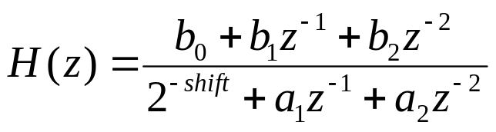
TAT: Audio Data Section – AULS
AULS is an 8th order ARMA filter built up with four biquads. Following is the transfer function for each biquad:
It is high pass filter which is used to increase the speech quality of the loudspeaker built in the mobile.
AULS is a separated HPF from HPF for FTA and CTA. It can be switched off during FTA or CTA
24 coefficients, calculated from a given frequency response via the help of AU_Design.m
Different sample rates need different coefficients

Slide 19
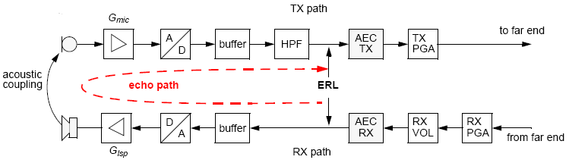
TAT: Audio Data Section – DENS
Echo path and gains
Notes:
<Application note for dsp audio parameters>

Slide 20
TAT: Audio Data Section – DENS
It can completely remove echoes while keeping nearly full-duplex operation.
ERL<+6dB, these parameter can work well
Different parameter sets are needed for:
Headset/bluetooth
Handset at ear
Hands-free, handset on table
Car-kit

Slide 21
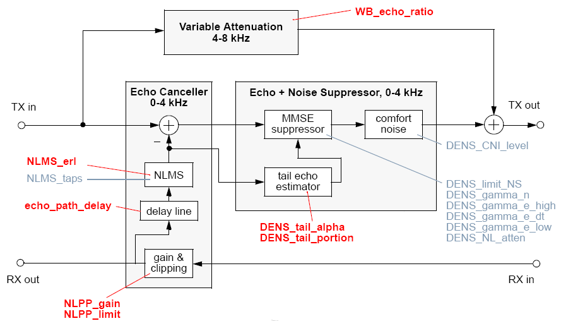
TAT: Audio Data Section – DENS
Red parameters have to be adjusted for proper operation
Gray parameters allow to customize the AEC for individual taste

Slide 22
TAT: Audio Data Section – DENS
DensMode: only useful during testing.
0x01: NLMS echo canceller
0x02: dynamic echo suppressor (DES)
0x04: noise suppression (NS)
0x08: comfort noise injection (CNI)
0x10: extra suppression of non-linear echoes by the DES
0x20: high-band mute/active
0x40: high-band variable attenuation off/active
0x80: non-linear preprocessing of the far-end signal

Slide 23
TAT: Audio Data Section – DENS
DensEchoPathDelay: Adjusted for proper operation.
This parameter must match the delay of the true echo path (DSP buffering + electro-acoustic delay).
EchoPathDelay = (true delay [ms] * 8) –20
The electro-acoustic delay is about 1 ~ 2 ms. For mobile, since MIC and louderspeaker are in the same hoursing,
EchoPathDelay = (DSP buffering [ms] * 8) –10
EchoPathDelay is too high or too low will induce no echo cancellation and unpredictable distortion of near-end signal.

Slide 24
TAT: Audio Data Section – DENS
DensNlmsTaps: customize for individual taste. Reduce this value can save MIPS, but the delay compensation must be more accurate.

Slide 25
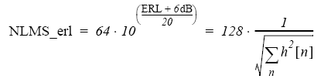
TAT: Audio Data Section – DENS
DensNlmsErl: adjusted for proper operation. Too low or too high will reduce the cancellation accuracy of the NLMS filter.

Slide 26
TAT: Audio Data Section – DENS
DensNlppGain:
adjusted for proper operation. (0 ~ 0x7FFF, 0 ~24dB).
Avoid non-linear echoes
To achieve high output volume, extra gain has to be inserted with NlppGain instead of Gisp

Slide 27
TAT: Audio Data Section – DENS
DensNlppLimit:
adjusted for proper operation. (0~0x7FFF, ~1).
Allows to clip the digital signal below its maximum amplitude to avoid analog clipping
This value should be near 1 so that not to waste D/A converter dynamics. It clip the digital signal

Slide 28
TAT: Audio Data Section – DENS
DensDensTailAlpha:
adjusted for proper operation. (0 ~ 0x7FFF)
DensTailAlpha = 32768 * 10 exp ( -0.03/T60)
T60 = 0.3 for room, T60 = 0.2 for car.

Slide 29
TAT: Audio Data Section – DENS
DensDensTailPortion:
adjusted for proper operation. (0 ~ 0x7FFF).
When the value of NlmsTaps > 160, this value is not very critical. Increase this value will increase early echo.

Slide 30
TAT: Audio Data Section – DENS
DensWbEchoRatio:
adjusted for proper operation.
Only for wide band operation.

Slide 31
TAT: Audio Data Section – DENS
DensSpdetXClip:
Extra suppression for non-linear echoes
when mode = 0x81, far end can heard distorted echo bursts of loud voice, that is non-linear echo exits, this parameter should be set. This is a threshold. ( 0 ~ 0x7FFF)

Slide 32
TAT: Audio Data Section – DENS
DensDensNlAtten:
customize for individual taste.
Extra suppression for non-linear echoes
when mode = 0x81, far end can heard distorted echo bursts of loud voice, that is non-linear echo exits, this parameter should be set. It is determine a minimum suppression that is applied to all frequency points above the maximum of the estimated echo spectrum. ( 0 ~ 0x7FFF)

Slide 33
TAT: Audio Data Section – DENS
DensDensGammaEHigh:
customize for individual taste.
For “ far end only” , set to high when far end can not heard echoes( 0 ~ 0x7FFF), which strong coupling.
value is recommend as 0x200
DensDensGammaEDt:
customize for individual taste.
For double talk, Increase will reduce echo.
DensDensGammaELow:
customize for individual taste.
For near end, avoid unnecessary echo suppression caused by far-end background noise.

Slide 34
TAT: Audio Data Section – DENS
DensLimitNs:
customize for individual taste.
This parameter set the maximum amount of noise suppression. Increase this value, suppress more noise. (0 ~ 0x7FFF)
DensDensGammaN:
customize for individual taste.
Set the sensitivity of the noise suppressor. (0 ~ 0x7FFF)

Slide 35
TAT: Audio Data Section – DENS
DensNlmsTwoalpha: 0x2000 set to this default value.
DensNlmsPresetCoefs: 1, default value
DenNlmsOffset: 0x148, default value
DensSpdetFar: 0x4000, default value
DensSpdetMic: 0x7333, default value
DensDensSpdetNear: 0x300, default value
DensDensNfeBlockSize: 400, default value

Slide 36
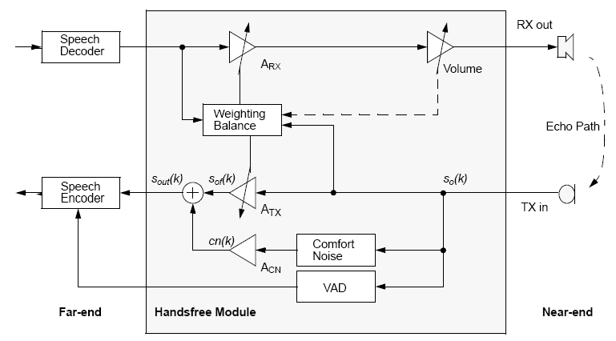
TAT: Audio Data Section – HF
HF module in car kit mode

Slide 37
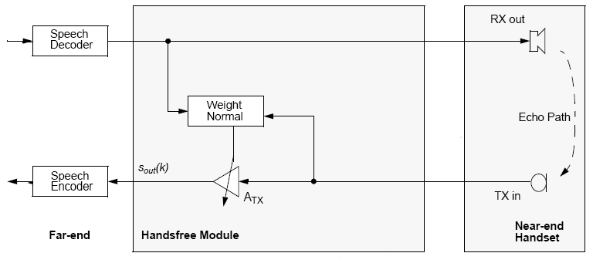
TAT: Audio Data Section – HF
HF module in handset mode

Slide 38
TAT: Audio Data Section – HF
HfControl:
Bit 8:6, HF _volume for carkit mode
0b00: highest volum
0b01: 3dB less than level0
0b10-0b110: 3*n dB less than level0
0b111: lowest volum, 21dB less than level0
Bit 9, hf_mode_flag
1: HF set for handset operation
0: HF set for car kit operation

Slide 39
TAT: Audio Data Section – HF
HfAttCorrection:
Decrease this value will increase echo and decrease half-dup effect.
Carkit mode: it has to be written with a correction value(correction/100dB)
Value Example: +10dB -10dB -20dB
0x0CCC 0XF333 0XE666
Handset mode: it has to be written by the total attenuation divided by 2 dB
Value Example: 0dB 0~40dB 40dB
0x0000 By user 0x0014

Slide 40
TAT: Audio Data Section – HF
HfAlphaAc:
AlphaAC is the smooth constant for the estimation of the acoustic attenuation value. It is only used in carkit mode. In handset mode att_ac is constant
Value Example:
0.0 0.0066 0.1
0x0000 0x013D 0x12C3

Slide 41
TAT: Audio Data Section – HF
HfFastAlphaAc:
FastAlphaAC has the same meaning as AlphaAC. FastAlphaAC is used at the beginning of handsfree operation, AlphaAC is used afterwards, This can be used to have a faster estimation at the beginning.
Value Example:
0.0 0.0066 0.1
0x0000 0x013D 0x12C3

Slide 42
TAT: Audio Data Section – HF
HfMaxLevelBGR:
MaxLevelBGR defines the maximal background level for the send in signal background estimation.
Value Example:
MinLevelBGR 60dB 70dB
0x4CCC 0x5994

Slide 43
TAT: Audio Data Section – HF
HfMinLevelBGR:
MinLevelBGR value defines the minimal background level for the send in signal background estimation.
Value Example:
20dB 40dB MaxLevelBGR
0x199A 0x3333

Slide 44
TAT: Audio Data Section – HF
HfThrNearEcho:
ThrNearEcho is a threshold value for the activity detection. If the send in signal is more than ThrNearEcho, that is louder than the expected echo, double talk is detected, otherwise far-active is detected.
Value Example:
1dB 3dB 9dB 20dB
0x147 0x3d7 0xB85 0x199A

Slide 45
TAT: Audio Data Section – HF
HfThrFarEcho:
ThrFarEcho is a threshold value for the activity detection. If the receive in signal is more than ThrFarEcho, that is louder than the expect echo, double talk is detected, otherwise near-active is detected.
Value Example:
1dB 3dB 9dB 20dB
0x147 0x3d7 0xB85 0x199A

Slide 46
TAT: Audio Data Section – HF
HfThrSendIn:
ThreshouldSendIn defines the level which is needed to detect speech activity on the send in signal. If the actual input level is higher than the estimated background level plus ThrSendIn, activity is detected.
Value Example:
1dB 3dB 9dB 20dB
0x147 0x3d7 0xB85 0x199A

Slide 47
TAT: Audio Data Section – HF
HfThrReceiveIn:
ThrReceiveIn defines the level which is needed to detect speech activity on the receive in signal. If the actual input level is higher than the estimated background level plus ThrReveiveIn, activity is tetected.
Value Example:
1dB 3dB 9dB 20dB
0x147 0x3d7 0xB85 0x199A

Slide 48
TAT: Audio Data Section – HF
HfCnFactor:
CnFactor can be used to change the comfort noise level. CnFactor = 0 means no comfort noise added to TX path.
Value Example:
0.0 0.5 <1.0
0x0000 0x4000 0x7FFF

Slide 49
TAT: Audio Data Section – RxVol
VolumeTable[0]…..[9]
Digital gain used in Rx direction, 10 user volume are defined. (0xFF ~ 0x01, 12dB ~ -36.12dB)

Slide 50
TAT: Audio Data Section – Compression
CompressionLevels[0], [1] ,…., [11]
10 values corresponding to the 10 user volume level are defined. Each value can be set from 0 to 5
Less the compression value is, more the amplification feeling in Rx direction.
0: off 1: 0.85
2: 0.75 3: 0.6
4: 0.55 5: 0.33

Slide 51
TAT: Audio Data Section – Path param
AfeHfr1Act: Select HFR1 output is set to 0x01
AfeHfr2Act: Select HFR2 output is set to 0x01
AfeEar1Act: Select EAR1 output is set to 0x01
AfeEar2Act: Select EAR2 output is set to 0x01
Notes:
HFR: hands free output

Slide 52
TAT: Audio Data Section – Path param
AfeDc1: If the HFR1 output is activated when this parameter is set to 1 the AC audio signal is suppressed and only DC component is keeping in order to be used as reference for one or several outputs. This setting avoids the using of serial capacitor needed for normal single ended mode.
AfeDc2: The same for HFR2
AfeDc3: The same for EAR1
AfeDc4: The same for EAR2

Slide 53
TAT: Audio Data Section – Path param
AfeEar1Pol: If set to 0x01, EAR1 has positive polarity and negative if set to 0x0.
AfeSumLr: L+R DAC output summation if set to 1
DspRxLpAct: 0x01, RX low pass filter is activated
DspRxHpAct: 0x01, RX high pass filter is activated
DspAulsAct: 0x01, AULS is activated; switched off during CTA and FTA test.

Slide 54
TAT: Audio Data Section – Path param
DspTxLpfAct: 0x01, TX low pass fileter is activated
DspTxHpfAct: 0x01, TX high pass filter is activated
DspDenAct: 0x01, DENS is activated
DspHfAct: 0x01, HF is activated

Slide 55
TAT: Audio Data Section – Path param
MicBiasAct: 0x01, MICBIAS (BAI) is activated
BaiDacStereoMode: 0x01, mono (1ADC); 0x00, stereo(2ADC)
BaiAdcStereoMode: 0x01, mono (1ADC); 0x00, stereo (2ADC)

Slide 56
TAT: Audio Data Section – Path param
AfeInputSel: Input selection and analog loop activation:
0x0: MIC input select to ADC
0x1: ANL/ANR select to ADCs
0x2, 0x3, 0x6, and 0x7: ANL/ANR inputs selected to RX output buffers
0x4: AUXMIC input selected to ADC
0x5: MIC and AUXMIC inputs selected to ADCs

Slide 57

Sy.Sol 6120:Acoustic Parameters Training (TAT)
Q & A

Slide 58


